Slide 1
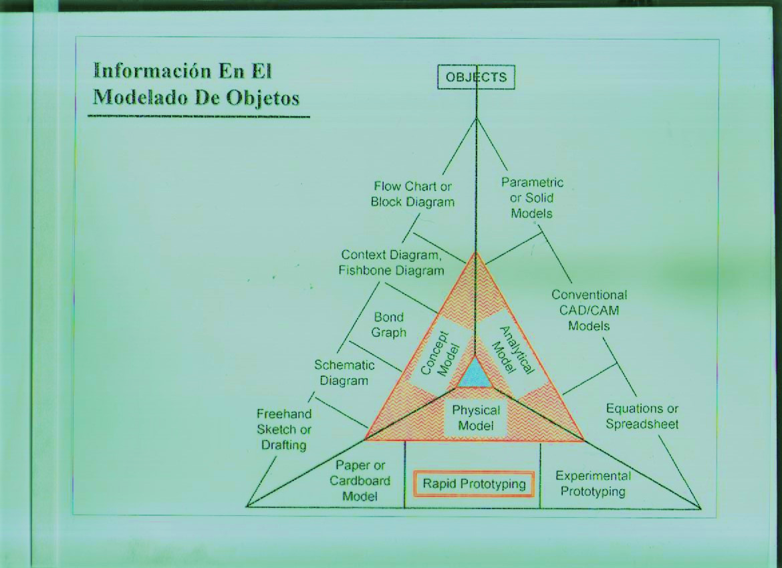
PROGRESSIVE FLOW INTO PRODUCT-PROCESS DESIGN TERNARY PHASES INFORMATION DIAGRAM

